Slide 1
Final presentation
Oraculi: A discussion forum
Sarthak Dubey• AT-2

Slide 2
Oraculi:A discussion forum.
What is Oraculi?
Oraculi is a site where students of IITK can discuss their doubts with their peers on any subject they’re studying here.
Any registered user can request to add a course they are studying and then users can ask/answer doubts and share study material for that subject (like previous year question papers, lecture notes, slides).

Slide 3

Features

Slide 4
User specific.
Oraculi is a user specific site, where users have to login before using it.
Students can register as new users easily on the website.
Discussions,files, folders, comments shows the user who has added them.

Slide 5
Ask. Answer. Learn.
Ask all the doubts you have, no matter the subject, through Oraculi’s add discussion option.
Add subjects if you’re an admin, or request a subject and it will be added shortly.
Any user can add comments to a question and start a discussion.

Slide 6
No problem if you’re shy!
Oraculi provides users with the option to add discussions and comments anonymously.
Just check the anonymous box while adding a discussion/ comment.

Slide 7
Stay updated on your discussions.
Oraculi has a ‘My Discussions’ tab where all the discussions added by a user can be seen in one place.
Number of comments on each discussion added is shown to keep users notified on the activity on their discussions.

Slide 8
Share files.
Oraculi has a file sharing centre for each subject, where users can create folders and upload and download files
The website checks the format of the file being uploaded so files of only selected formats are upload and no junk gets accumulated.
There’s no more need to waste time searching for past years’ papers, lectures etc. Just join Oraculi and you’ll have it all in one place.

Slide 9
No one can delete your uploads, except you.
Oraculi provides you with an option to delete anything you’ve uploaded/created.
Before deleting, the website verifies your user id, and if it does not match, delete command is not executed and error message appears.
No one but you can delete the discussions, files etc you’ve uploaded.

Slide 10
Work done after mid-term presentation

Slide 11
Login service implemented
Functions to login, logout and register a user were added
Django already has database tables for users and login and registration modules.
User form was tweaked to remove useless fields like first name, DOB etc.
Login and register functions were written.
All previous functions were modified to check whether user is logged in or not before executing.
All database tables were modified and linked to users’ table.

Slide 12
Rewritten views.py
All the functions before mid-term were written as classes
Django has ready-made modules called generic views like create, delete, update, list view, detail view etc where classes are read as functions by the website and minimum amount of code needs to be written
All functions before mid-term were written as classes, but these classes do not offer much customization.
Views.py now has all python functions.
Due to limited freedom of customization and problems faced when implementing login service, all classes were re-written as python functions.
Functions help solve login problems, check verify users before executing functions like delete, add subject, pass various variables to show all subjects on navigation bar on each page etc.

Slide 13
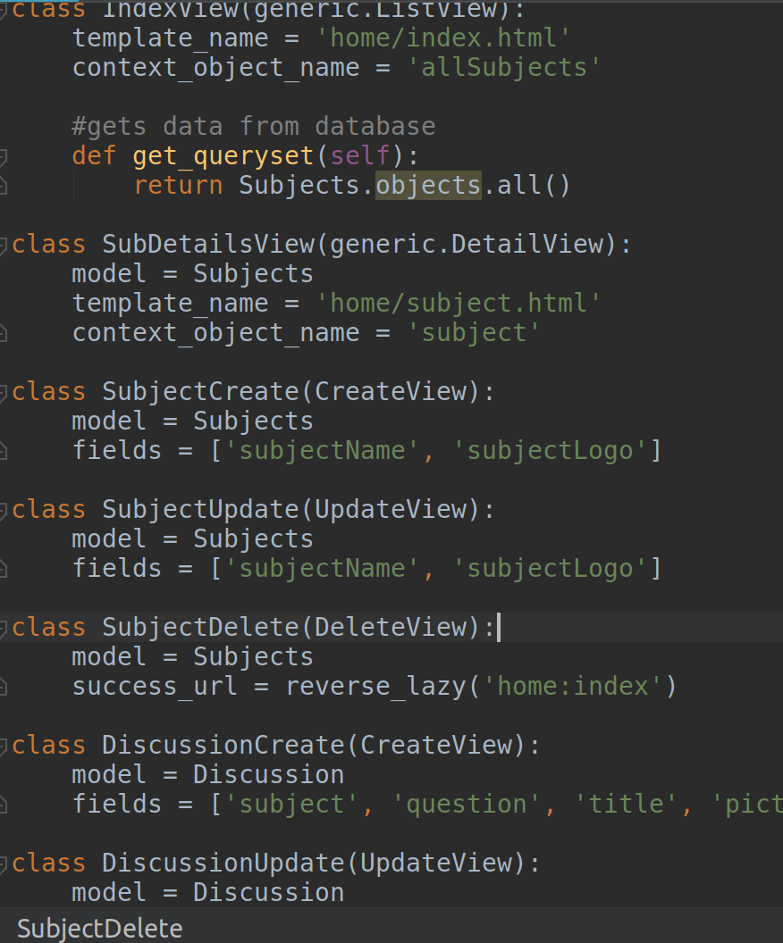
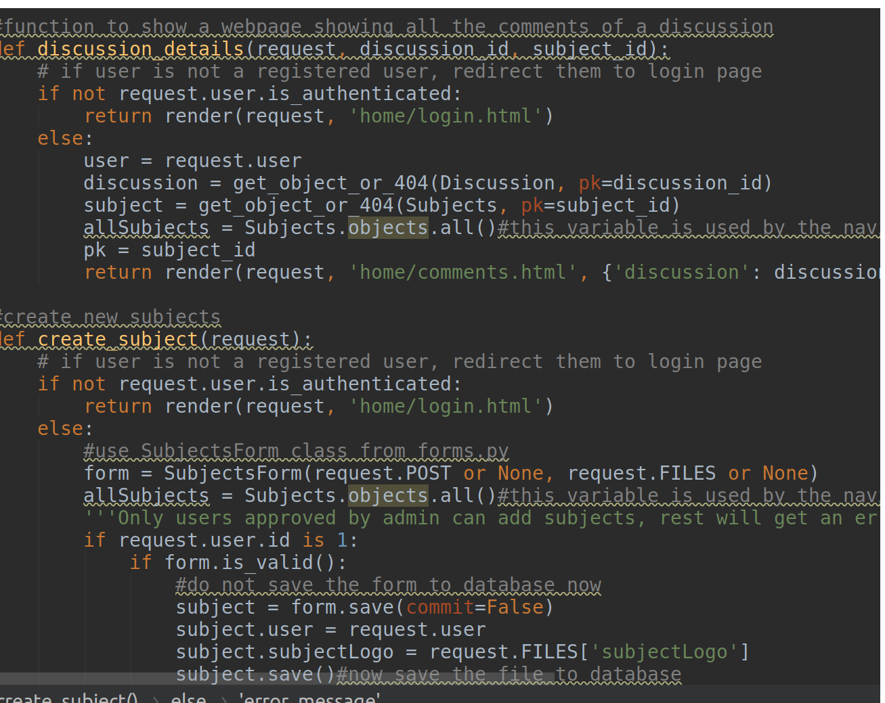
Rewritten views.py
Old views.py with classes
New views.py with functions

Slide 14
Forms
Forms to add subject, discussion, comments, folders, file and users have been added.
Django has pre-defined user module which has been tweaked in the file forms.py to remove useless fields like first name, DOB etc.
Forms.py has form modules for all the forms so there’s no need to created separate html file for each form. Instead a base html file(form_template.html) loops through all the variables of a module (or columns of a table in database) included in forms.py.
The variables of module not included as form fields in forms.py are auto-filled by requesting the data from the current webpage.
For example, there are two separate functions to add a discussion. One of them(create_discussion_index()) is executed when user is adding a discussion from a webpage other than the webpage for a subject. In this case, there is a form field to add subject. The other function(create_discussion_sub()) is executed when user in on the subject’s webpage and no form field for subject is present. The subject id(or pk) is requested from the webpage and added to the form by the function.

Slide 15
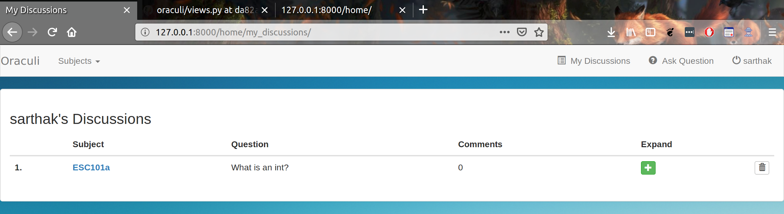
My Discussions
A ‘My Discussions’ tab has been added to the navigation bar where a user can view all their discussions.
It shows number of comments in each discussion so the user will be notified when a the number of comments on a discussion changes.

Slide 16
Delete/create functions added
Functions to delete/create discussion, comment, file, folder have been added
Delete functions are executed only if the user requesting the execution of the function is same as the user who has created/uploaded the file.
If users do not match, an error message is shown.
Subjects can be added only by those users who have admin’s permission.
Discussions, comments, folders and files can be added by any user.

Slide 17
File Sharing centre
Users can share files using file sharing centre
There is a separate file-sharing page for each subject
Users can create folders in each page, for eg a folder for past years’ mid-sem papers.
Files can be uploaded in each folder by the users.
File format is checked by extracting the extension of file name from file name string.
Only selected formats(jpg, jpeg, png, pptx, ppt, pdf, txt) can be uploaded to avoid uploading junk files.
Files can be downloaded from links on each file.
There is no option to post files anonymously.

Slide 18
Other changes made after mid-sem
Users can add images (added file format is verified same as in file sharing and accepted only if it is either .jpg, .jpeg or .png) on their discussions, comments(optional).
New model classes (database tables) for files and folders have been added and were ones have been modified.
New functions to render various web-pages, add to database etc have been added added.
New urls and HTML templates were created.
Bugs were fixed(for eg. navigation bar had subjects drop-down button but it worked only on homepage).
Change in website’s design.

Slide 19
File Organisation.

Slide 20
Demo.

Slide 21
Future Work.

Slide 22
Future Work
The site has a lot of scope for future development, and following are some functions which I’m looking forward to implement:
Search functionality: A function to search discussions, comments, folders and files can be added. Database can be changed to add involve tags in discussions, files etc and then these can be searched by tags, or by their name/title.
Favourites: Feature to favourite discussions/files can be added and users can later view the discussions/files they’ve favourited.
Mobile app: A mobile app for the website can be made.
More features for instructors: Instructors using Oraculi can be given extra user privileges like adding subjects, making announcements, creating groups etc.
Improving design: JavaScripts can be included in template files to make the site look more attractive and beautiful

Slide 23
Credits.

Slide 24


Languages learnt from:
HTML/CSS/Bootstrap: W3schools.com
Python: newboston python tutorials (YouTube)
Django: newboston Django tutorials and Max Goodridge Django tutorials (YouTube)
Other sites used:
Stackoverflow.com
Online repository: github.com
IDE: pycharm by jetbrains
HTML templates adapted from newboston Django tutorials, W3schools.com .
Icons used: glyphicon
User registration function adapted from: newboston Django tutorials.

Slide 25
I would like to give a special thanks to the instructor and all the project mentors for their support, guidance, constant motivation and most importantly for having faith in me.

Slide 26
Thank you!

